Slide 1
Office 365 Connectors for Groups
Rubén Toribio Gallardo
Notes:
This slide is mandatory. Please do not remove.

Slide 2



Rubén Toribio Gallardo
Sharepoint / Office 365 Architect
Beezy
https://es.linkedin.com/in/rubentg
@Rtoribiog
Passionate about new technologies, interested in working with the new tools available in the market.

Slide 3
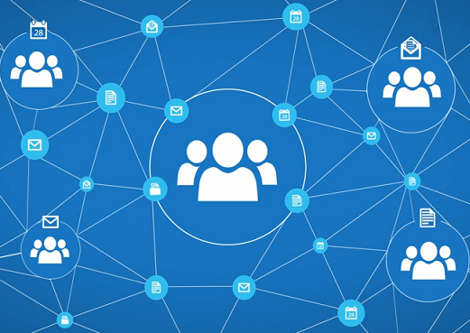
Office 365 Connectors for Groups

Slide 4
Index
What’s Office 365 Groups
Office 365 Groups in Future
What’s is Office 365 Groups Connectors
How to Configure Default Connectors
Register Custom Connector
Connectors Test Environment
Office 365 Connector card
Office 365 Connect Button
Publish our own Connector
Custom Application with Connect Button

Slide 5
What’s Office 365 Groups
Exchange ? SharePoint ? What else?

Slide 6
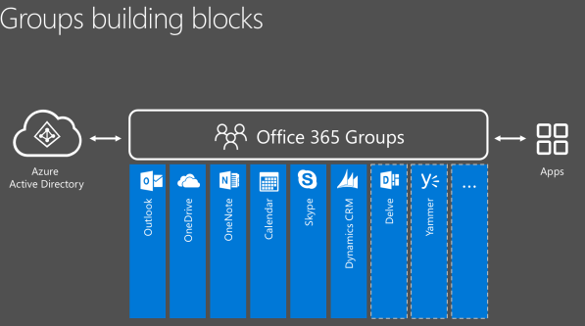
What’s Office 365 Groups

Slide 7
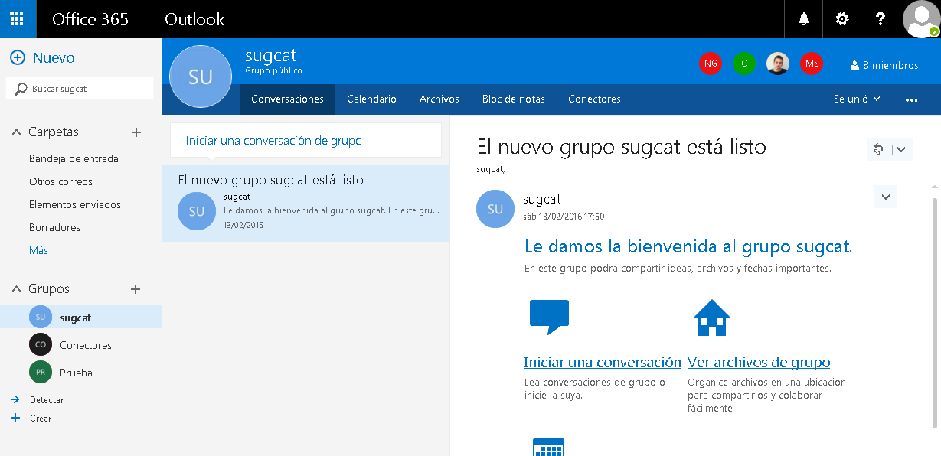
What’s Office 365 Groups

Slide 8
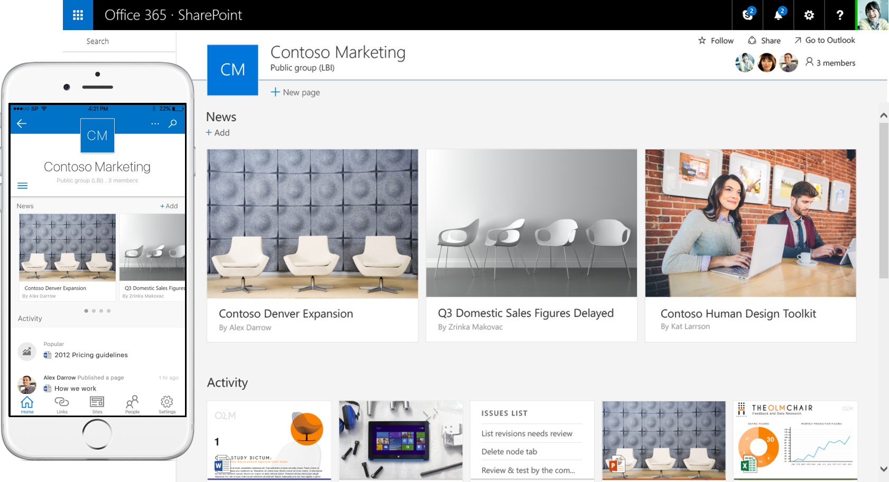
Office 365 Groups in Future
the power of SharePoint team sites and Office 365 Groups together, giving every group a team site, and giving team sites the benefit of groups for simple management of membership across Office 365 services

Slide 9
What’s is Office 365 Groups Connectors
Connected , Connected Everywhere

Slide 10
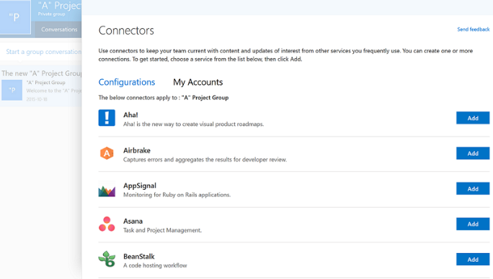
What’s is Office 365 Groups Connectors
A connector is a feature that allows us to send information in real time to our office 365 time groups from other services or platforms, from an external system or a proprietary system.

Slide 11
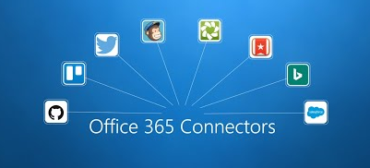
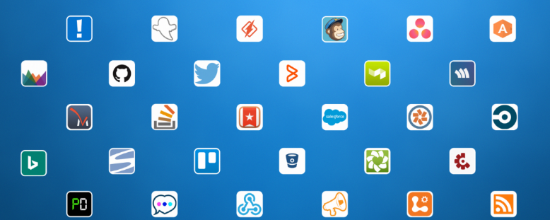
What’s is Office 365 Groups Connectors
Services Available
Popular Services
Subscription
Account in every
platform needed

Slide 12
How to Configure Default Applications
Let’s try it

Slide 13



How to Configure Default Connectors
Real Scenarios
Development
Every time I do a release , send a message : Visual Studio Online + Office 365 Connector
Management
Every time I open a task , send a message : Jira + Office 365 Connector
Communication
Every time I tweet something , send a message : Twitter + Office 365 Connector

Slide 14
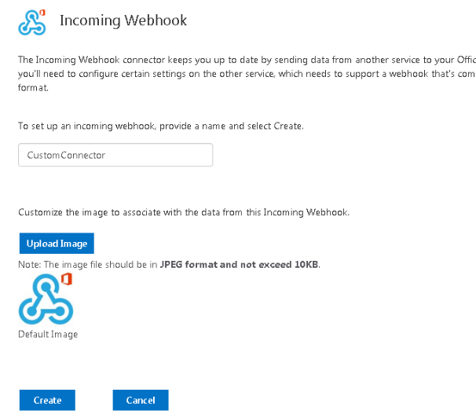
Register Custom Connector
We need a connector to private system
We send information to group
Connector have unique url
We have to call this url , no authentication

Slide 15
Register Custom Connector
Let’s try it

Slide 16
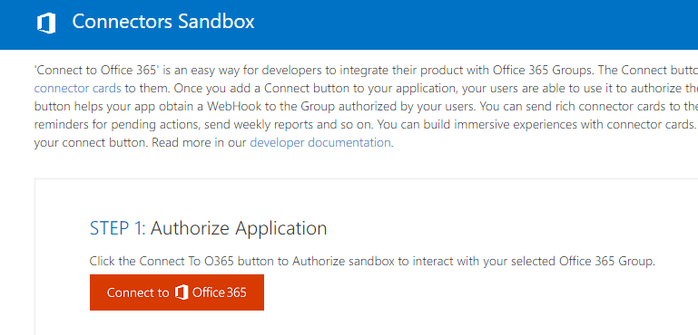
Connectors Test Environment
We need to test our system
Sandbox cloud environment
Post Message to group
http://connectplayground.azurewebsites.net/

Slide 17
Office 365 Connector Card
Which UI we have.

Slide 18
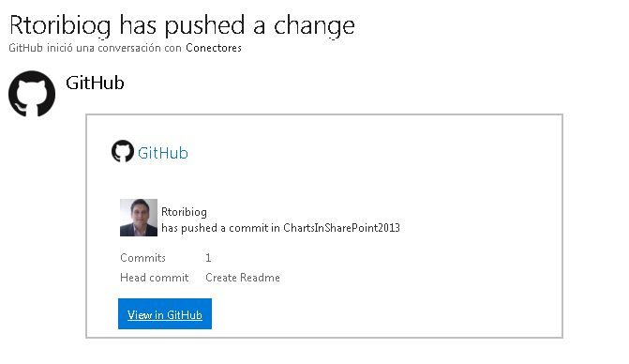
Office 365 Connector Card
Is the way to see the information
Generic and Unified Interface

Slide 19
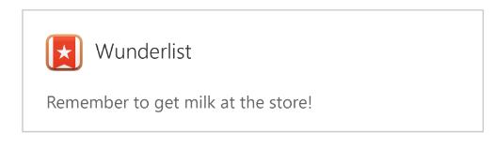
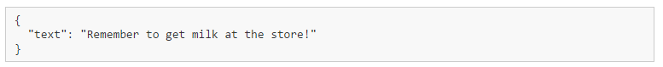
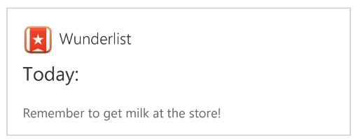
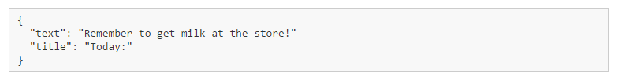
Office 365 Connector Card
Different types:
Message
Message with Title.
Message with Link.
Message with Action.
Message with Color.

Slide 20
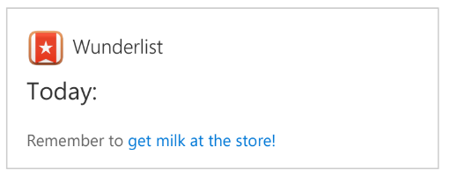
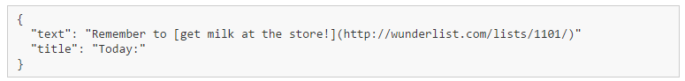
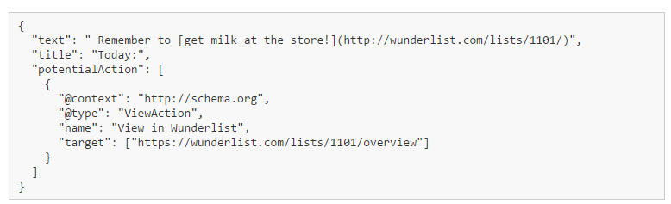
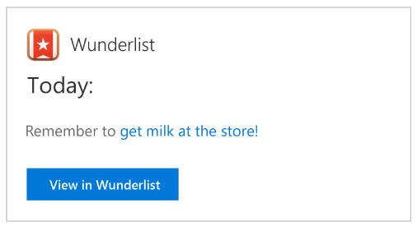
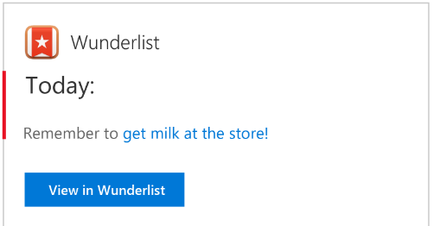
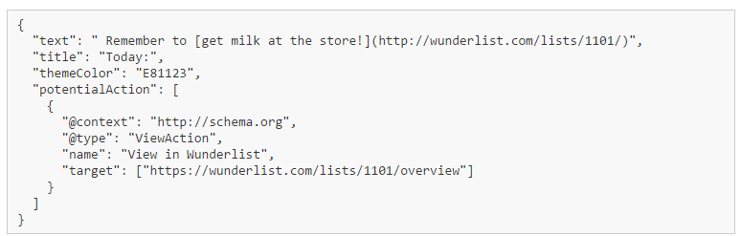
Office 365 Connector Card

Slide 21
Office 365 Connector Card
The content in a section is displayed in the following order (top to bottom):
Title
Text
activityTitle,activitySubtitle,activityText
Facts
Images
actions

Slide 22
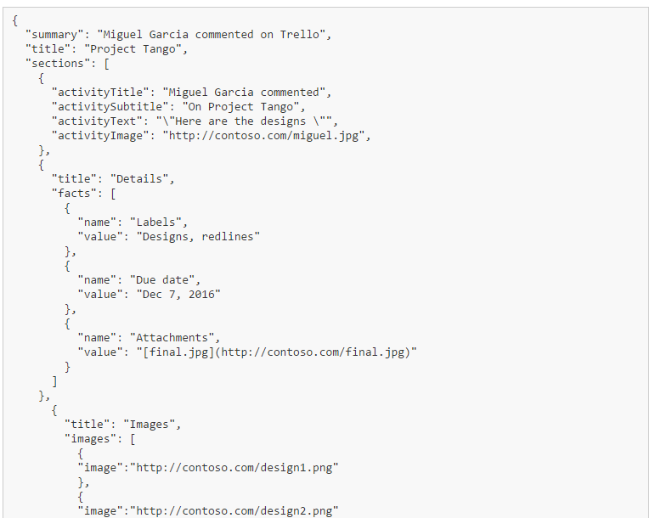
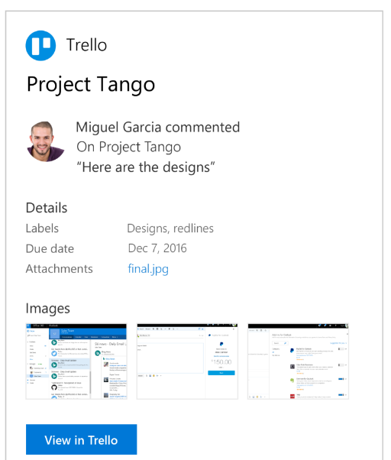
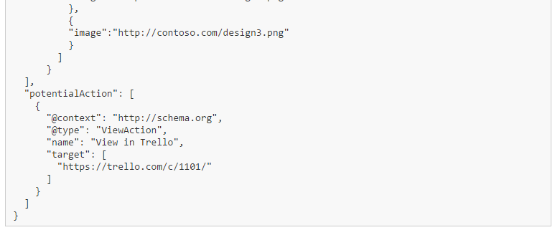
Office 365 Connector Card

Slide 23
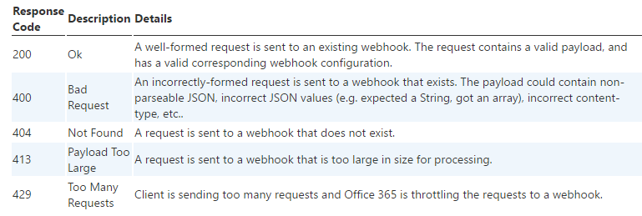
Office 365 Connector Card
Response Code
Important : Content-Type: application/json in Headers

Slide 24
Office 365 Connect Button
Let’s start

Slide 25
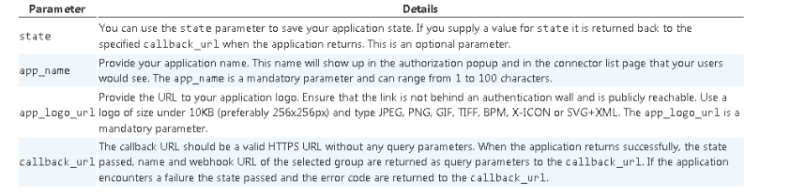
Office 365 Connect Button
The way to register a custom connector automatically.
There are a structure to create a button to connect with office 365
With the following parameters

Slide 26
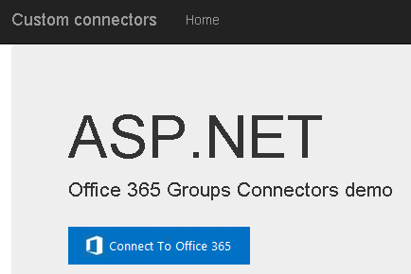
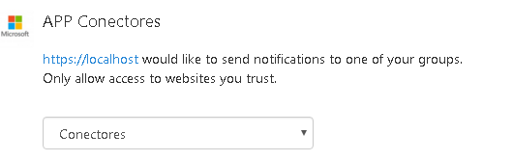
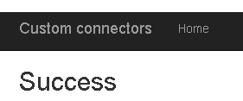
Office 365 Connect Button
Flow :
We define the Connect Button
When de button is clicked , the user select a group and the connector is registered.
The service returns to the callback url , the webhook url.

Slide 27
Publish our own Connector
Makes our application to connect everywhere

Slide 28
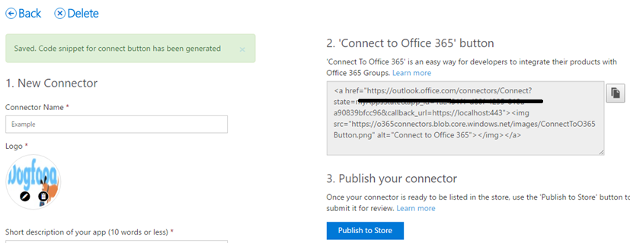
Publish our own Connector
Introducing the Connectors Developer Dashboard beta
Now you can build your own connector through our developer portal
Visit the Connector Developer Portal
It will autogenerate Office 365 button

Slide 29
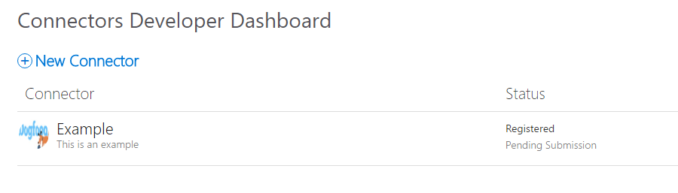
Publish our own Connector
We have to test it , and later Microsoft will approve it.

Slide 30
Custom Application with Connect Button
Let’s Code

Slide 31
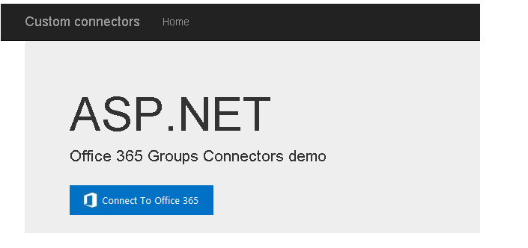
Publish our own Connector
Lets develop an application:
ASP MVC
Office Button

Slide 32
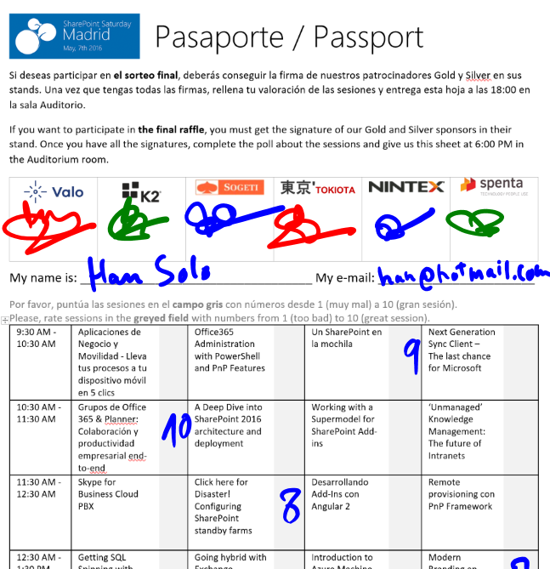
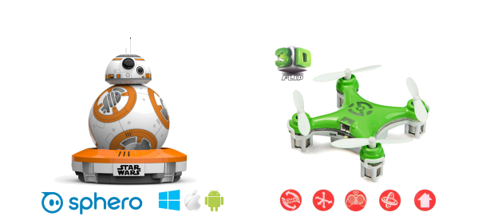
Raffle
Please, fill your SPS Madrid passport if you want to participate.
You must get signature from sponsors and complete the poll.
Give us the passport at 6:00 PM in the Auditorium room.
You can win one Sphero BB-8 or a mini drone:

Slide 33
Q & A
Thanks

Slide 34
Notes:
This slide is mandatory. Please do not remove and try to use it during Q&A at the end of your session. Thank you!

